Slide 1
Sustainability Planning for Infant-Toddler Court Teams
Sustainability Webinar Series
March 9, 2022

Slide 2
Introduction to Sustainability Webinar Series
This webinar is the first in a series that will focus on strategies to sustain Infant Toddler Court Teams in states and local communities.
Future webinars will touch on other aspects of sustainability planning, including cultivating champions, developing collaborative partnerships, financing, and building internal capacity.
This program is supported by the Health Resources and Services Administration (HRSA) of the U.S. Department of Health and Human Services (HHS) as part of an award totaling $19,581,161 with 0 percent financed with non-governmental sources. The contents are those of the author(s) and do not necessarily represent the official views of, nor an endorsement, by HRSA, HHS, or the U.S. Government. For more information, please visit HRSA.gov.
Notes:
Great to hear from Florida; lots of the elements we’ll talk about today
We’ll start out by defining what we mean by sustainability.
This is a definition from the Healthy Communities Initiative from the CDC, but I liked it for a few reasons.
You will notice right up front, that we are not just talking about funding; but also
Maximizing community assets and resources
Institutionalizing policies and practice
Involving a multiplicity of stakeholders
These are all related to our key elements of sustainability that I’ll go over in a minute

Slide 3
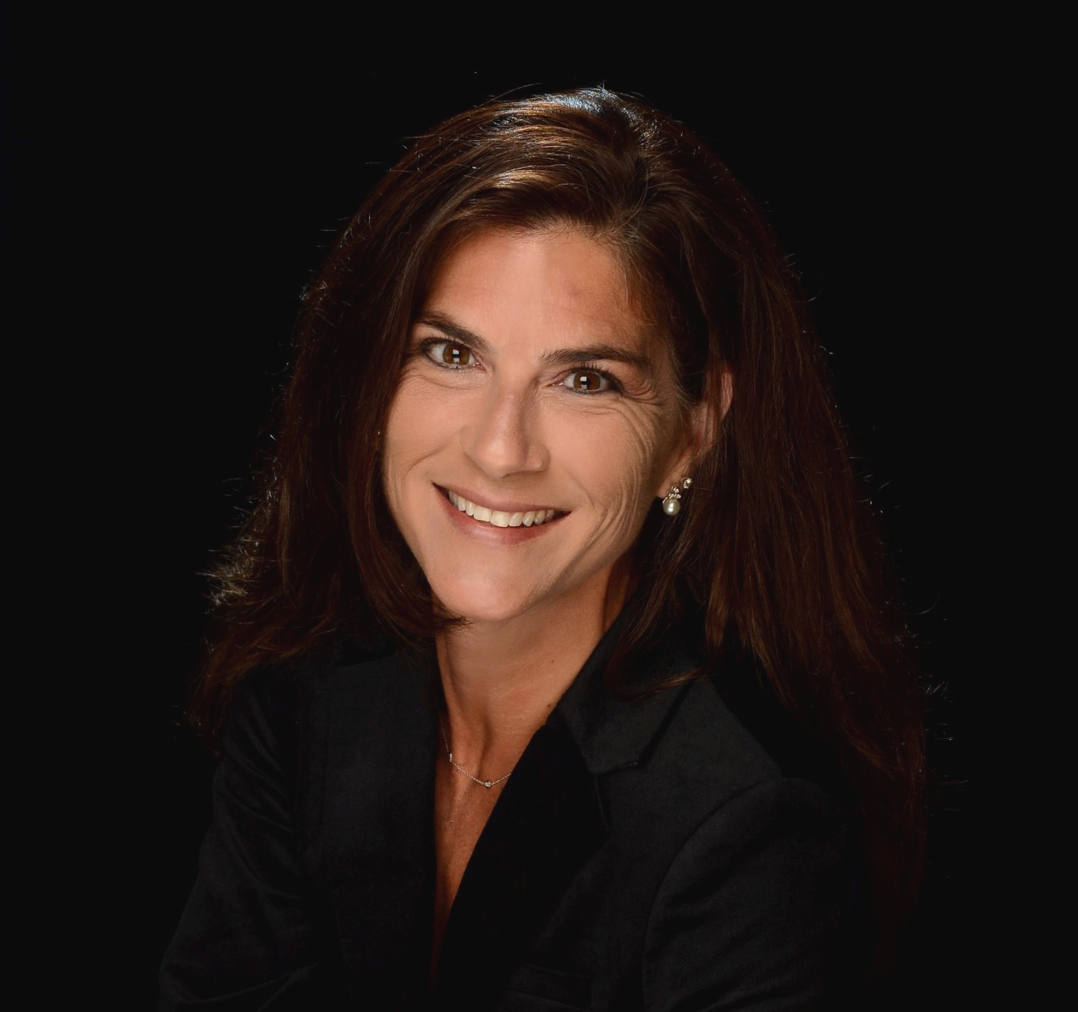
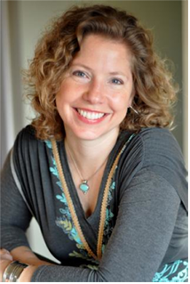
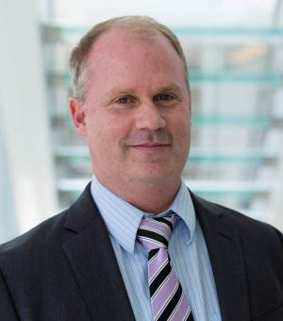
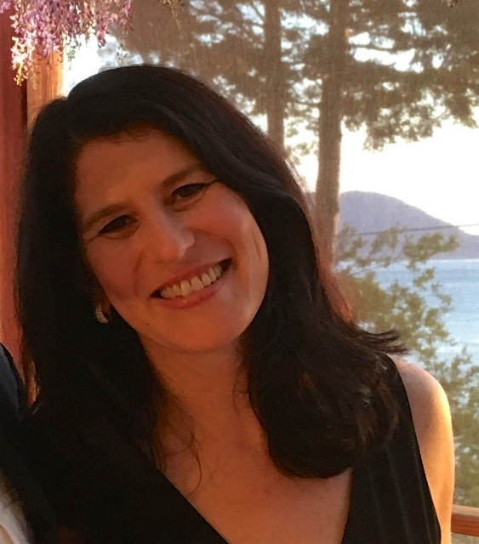
Today’s Speakers
Rachel Sottile, President & CEO at Center for Children & Youth Justice (CCYJ)
Kelly Warner- King, Manager of the Family & Youth Justice Programs at Washington State Administrative Office of the Courts
Torey Silloway, Director, Policy and Financing at National Infant-Toddler Court Program, ZERO TO THREE
Morgan Silverman, Director of Innovation at Center for Children and Youth Justice (CCYJ)
Notes:
Great to hear from Florida; lots of the elements we’ll talk about today
We’ll start out by defining what we mean by sustainability.
This is a definition from the Healthy Communities Initiative from the CDC, but I liked it for a few reasons.
You will notice right up front, that we are not just talking about funding; but also
Maximizing community assets and resources
Institutionalizing policies and practice
Involving a multiplicity of stakeholders
These are all related to our key elements of sustainability that I’ll go over in a minute

Slide 4
What Is Sustainability?
“Sustainability is not just about funding. It’s about creating and building momentum to maintain communitywide change by organizing and maximizing community assets and resources. It means institutionalizing policies and practices within communities and organizations…involving a multiplicity of stakeholders who can develop long term buy-in and support throughout the community for your coalition’s efforts.
These elements are crucial to ensuring lasting change and making a difference in people’s lives.”
Source: Centers for Disease Control and Prevention (CDC), A Sustainable Planning Guide for Healthy Communities
Notes:
Great to hear from Florida; lots of the elements we’ll talk about today
We’ll start out by defining what we mean by sustainability.
This is a definition from the Healthy Communities Initiative from the CDC, but I liked it for a few reasons.
You will notice right up front, that we are not just talking about funding; but also
Maximizing community assets and resources
Institutionalizing policies and practice
Involving a multiplicity of stakeholders
These are all related to our key elements of sustainability that I’ll go over in a minute

Slide 5
Key Elements of Sustainability for Infant-Toddler Court Teams
Resources
Financing
Policy, Regulations, and Legislation
Collaboration
Common Vision
Continuous Quality Improvement (data and learning)
This sustainability framework developed collaboratively with our partner the Center for the Study of Social Policy

Slide 6
Key Steps in Sustainability Planning
Organize your planning team
Determine common vision and goals
Conduct scan of key partnerships and areas of collaboration
Develop strategies for cultivating key champions
Identify fiscal strategies
Write the sustainability plan
Notes:
Self Assessment: Organize the planning team, take an inventory of past work and other assets already present within the collaborative related to sustainability, and determine how to adapt the rest of the planning process in order to fully leverage those assets.
Set Sustainability Vision and Goals: This phase addresses the most fundamental questions about sustainability. Exactly what is it we are trying to sustain? To achieve what end results? At what level of activity? For how long?
Plan for Capacity and Community Support: In this phase, strategies are developed to address four critical elements of sustainability: Broad Based Community Support, Key Champions, Ability to Adapt to Changing Conditions and Strong Internal Systems. A related issue addressed here is how to build and sustain strong strategic partnerships
Create a Strategic Financing Plan. Finances can be addressed at this point because the results of the preceding phases create a clear picture of the resources that are needed to ensure sustainability and why those resources are needed. Financial planning will involve developing strategies to control costs and coordinate resources as well as strategies to diversify and strengthen revenue streams, leading to a long-term (typically ten-year) forecast of revenues and expenses that shows the effect of the fiscal strategies. Any additional capacity building needed in order for the initiative to implement its fiscal strategies will also be identified
Write the sustainability plan:

Slide 7
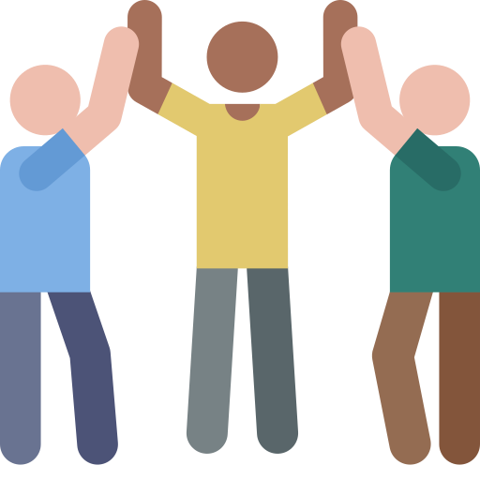
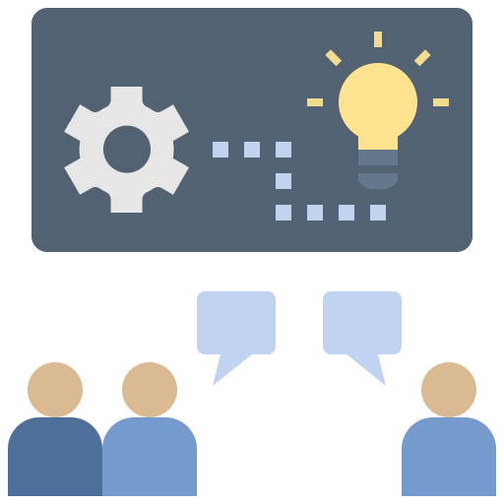
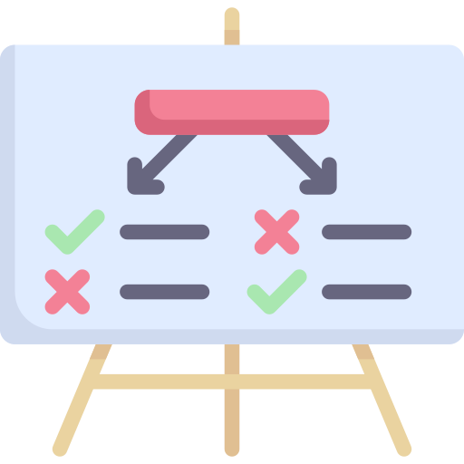
Getting Started: WHO, WHAT, HOW
WHO: Organize your planning team
HOW: Determine how you will undertake the planning process
WHAT: Establish the focus and goals for sustainability planning
Images from Flaticon.com

Slide 8
Getting Started: 1. WHO
WHO: Organize your planning team
Who do you need to involve?
What are their roles?
Who should lead the sustainability planning process?

Slide 9
Getting Started: 2. HOW
HOW: Determine how you will undertake the planning process
How will you organize your planning group (Is there a core group? Do all members participate in all meetings, or will you engage stakeholders at different points)?
What do the meetings look like (e.g., frequency, expected contributions outside of meetings)?
How will you communicate decisions and progress to stakeholders?

Slide 10
Getting Started: 3. WHAT
3. WHAT: Establish the focus and goals for sustainability planning
What would a successful sustainability planning process result in?
How will the sustainability planning process align with identified needs?
What are the goals for sustaining the Infant-Toddler Court Team?

Slide 11
Self-Assessment
 | Rating 1 to 5 | Strengths | Weaknesses
Common Vision We have a common vision of what the work should look like. We understand the key components of the approach and which elements are critical to sustain.
Collaboration We have identified key organizations and partnerships we want to continue. We know which new partnerships we want to build to expand our impact and have identified strategies to engage these new partners. We have identified key decision makers at the state or community level who can influence our project’s sustainability.
Finance We have considered and identified a range of funding sources (including federal, state/local, and private) that could support this work. We have developed and implemented strategies to access other funding sources, such as writing or collaborating on grant proposals.
Rating: 1 = Have not started this task; 2 = Have started initial planning work; 3 = Have begun to implement this task;
4 = Have made significant progress in implementing this task; 5 = Have made significant progress in completing this task

Slide 12
Self-Assessment
 | Rating 1 to 5 | Strengths | Weaknesses
Resources We have considered and identified in-kind or non-financial support from the community (e.g., volunteers, space, or materials) to support this work.
Policy We have considered and identified policy changes (e.g., legislation, rules, regulations) that would help expand the reach of the ITCP. We have developed strategies to reach out to key stakeholders who are willing to promote or support these policy change efforts.
Continuous Quality Improvement (data and learning) We regularly track and report on key data measures and are able to demonstrate our impact with families. We use data to inform our work with families, including identifying gaps in services and supports and to develop new strategies to improve outcomes.
Rating: 1 = Have not started this task; 2 = Have started initial planning work; 3 = Have begun to implement this task;
4 = Have made significant progress in implementing this task; 5 = Have made sufficient progress in completing this task

Slide 13
Conducting an Implementation and Sustainability Planning Process
Rachel Sottile, President & CEO, Center for Children & Youth Justice
Kelly Warner-King, Manager, Family & Youth Justice Programs, Administrative Office of the Courts
Morgan Silverman, Director of Innovation, Center for Children & Youth Justice

Slide 14
About Us
Center for Children & Youth Justice
Our mission is to create better lives for generations of children and youth by reforming the child welfare and juvenile justice systems
CCYJ convenes and partners with stakeholders, systems professionals, parents, legislators, and advocates across the state to develop and advance approaches to systemic change
Family & Youth Justice Programs, Administrative Office of the Courts
Our mission is to transform systems to promote thriving families and equitable court communities.
Our organizations work together collaboratively,
as part of a public/private partnership
14

Slide 15
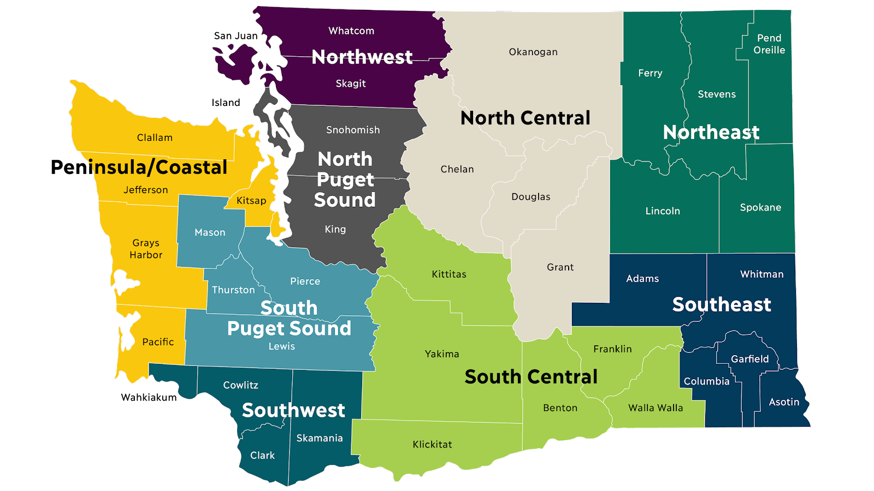
How Early Childhood Courts Began in Washington
CCYJ has history of involvement with this work
Statewide expansion planning began in early 2020
Sustainability planning is an ongoing process
Courts currently operating an ECC
Court preparing for ECC rollout
15

Slide 16
Project Overview
In January 2020, CCYJ was asked to determine the feasibility of expanding the SBCs in Washington State
CCYJ was tasked with developing an Implementation Plan that
Comprehensively identified the specific needs in our state
Mapped a path for a long-term, sustainable strategy for implement and expansion
Maintained fidelity to the SBCT approach
Centered those with lived experience
Created excitement and buy-in at all levels
We recognized the public/private partnership was key to our success
16

Slide 17
Planning for Sustainability Through a Formal Partnership
CCYJ
AOC
Statewide initiatives
Funding
Policy and Legislation
Convenings
Understand local court culture
Access to data
Stakeholder relationships
Judicial partnerships
17

Slide 18
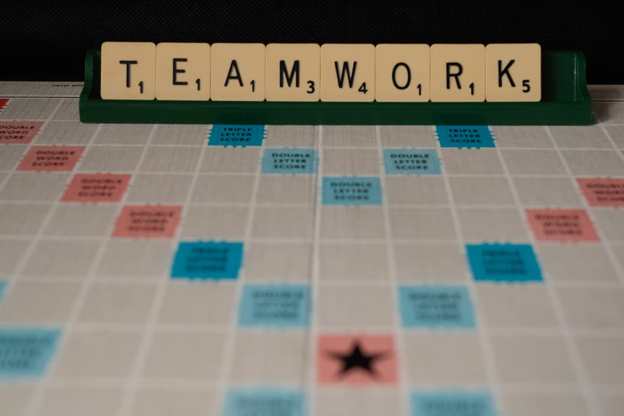
Co-Design with System Partners
Inclusive approach
Parent voices front and center
Virtual meetings designed to
Build relationships and ownership
Understand the need and the approach
Create Washington’s vision and mission
Keep families together and connected
Address disproportionality
18

Slide 19
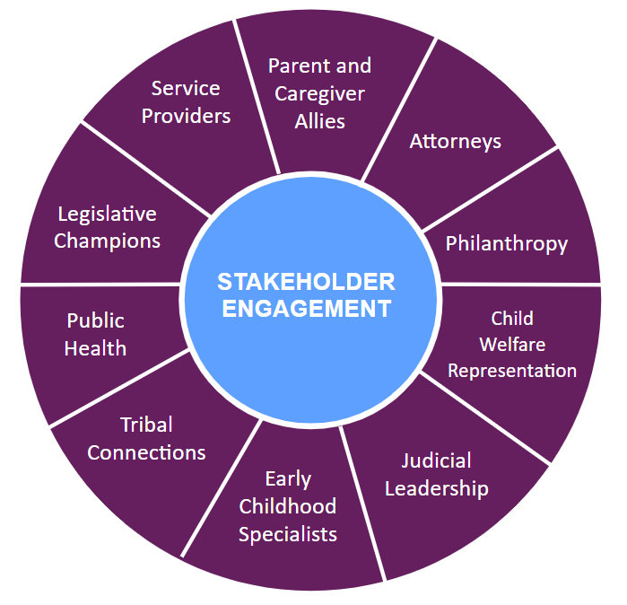
Overview of the Planning Process
Engaged stakeholders across WA to join a Design Team and develop the implementation plan
Addressed various components of the plan through larger Design Team meetings and smaller workgroups
Included individuals of various expertise, including parent allies
Maintained stakeholder communication and momentum throughout process
Set the direction for our state and applied for funding
19

Slide 20
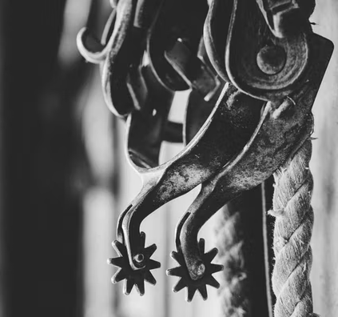
Court Context
Washington is a non-unified court system
Challenge: Build a statewide system that supports fidelity to the core components while maintaining local control and character
20

Slide 21
Focusing on Sustainability: Legislation
Sustainability was a focus from the start of our work
Legislative strategy includes long and short-term goals
Impact of the pandemic
Legislative process was complicated
21

Slide 22
Focusing on Sustainability: Long Term Plans
Expect CCYJ and AOC’s roles to shift over the years
Considerations for sustainable funding for the courts
Work in progress!
22

Slide 23
Focusing on Sustainability: Long Term Plans
Partnership
CCYJ and AOC launch program
CCYJ provides policy, funding and legislative advocacy
AOC will eventually take over running the program long term
Next steps
Sustainable funding for ECC Coordinators
Expanding service array
23

Slide 24
Lessons Learned
Stakeholder buy-in
Understanding the priorities in our own state
Focus on cross-sector partnerships
Realistic expectations of the legislative process
24

Slide 25
Thank you!
Please feel free to reach out with any questions
Rachel Sottile rsottile@ccyj.org
Kelly Warner-King kelly.warner-king@courts.wa.gov
Morgan Silverman msilverman@ccyj.org

