Slide 1
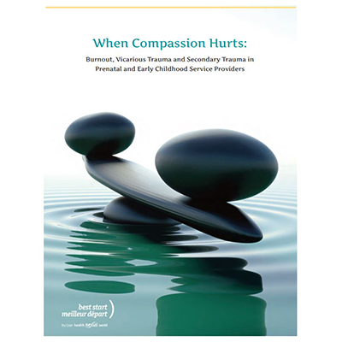
Understanding and Addressing Secondary Trauma and Compassion Fatigue: Risk and Protective Factors during COVID-19
Joy D. Osofsky, Ph.D.
Professor of Psychiatry and Pediatrics
Darneshia Allen
Director of Practice and Field Operations, ITCP
ZTT Infant Toddler Court Program │
January 14, 2021
Notes:
JOY

Slide 2
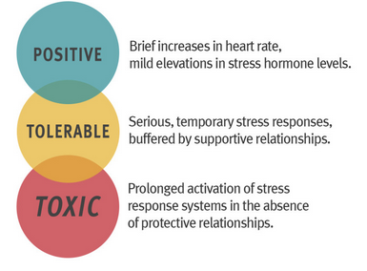
During this presentation: “slowing down and noticing our own thoughts and feelings”
https://developingchild.harvard.edu/science/key-concepts/toxic-stress/
Notes:
JOY

Slide 3
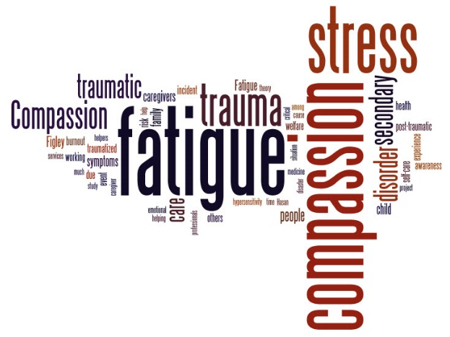
A MOMENT TO REFLECT…
Thinking about the side effects of supporting others:
Choose 1 or 2 words that reflect what you may be feeling
www.menti.com
Enter Code:
6538 5291
Notes:
Darneshia
Using menti-meter to have the audience generate a word cloud

Slide 4
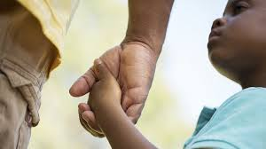
Defining the Problem
Vicarious Traumatization
“. . .refers to the cumulative effect of working with survivors of traumatic life events. Anyone who engages empathically with victims or survivors is vulnerable.” (Pearlman & Saakvitne, 1995, p.31.)
Notes:
JOY

Slide 5
Secondary Traumatic Stress
Stress resulting from helping or wanting to help a traumatized or suffering person (Figley, 2002)
Caused by repeatedly hearing stories about stressful events/trauma
Helping professionals as all are who work with ITCP are at high risk and can be highly impacted
Notes:
JOY

Slide 6
The Costs of Caring: The same attributes that make us good at our work have a cost Figley, 1995
“It is not possible to work on behalf of human beings to try to help them without having powerful feelings aroused in yourself.” (Pawl, 1995)
Therefore, we must be able to experience, tolerate, verbalize, and hold trauma and pain that we see in families that we try to help
It’s important to be aware of additional feelings. COVID-19 has contributed to the difficulties with our work
Notes:
JOY
Therefore, we must be able to experience, tolerate, verbalize, and hold the trauma and pain that we see in children and families

Slide 7
Acknowledging the Role/Expectations for Professionalization of Child Welfare Staff
Professionalization as First Responders and Expectations as Essential Personnel
Supporting Staff Performance and Retention – Through a Trauma Lens
https://www.childwelfare.gov/topics/management/workforce/workforcewellbeing/burnout/
Notes:
Darneshia with the slide - Joy gives the example of Hurricane Katrina
Professionalization as First Responders:
“A caseworker is required to make potentially life or death recommendations and decisions every day with every telephone call, visit, and activity. It is, without exaggeration, one of the most important positions in government and in society.” – PCG Human Services
Shared duties of first responders including child welfare workers:
They respond to crises in the community
They perform their duties as an emergency
Their role has to be available (at least on call) 24 hours a day, seven days a week
They are required to travel to the emergency or crisis
They interact with people who are vulnerable, injured, or possibly angry and aggressive
They must be prepared to make life or death decisions on the scene
They literally enter the unknown and must be trained and prepared to address any situation once they are there
They prepare for the potential for secondary trauma – particularly where children are involved
What makes this more difficult/complex during a pandemic is that often caseworkers are doing this on weekends, nights or holidays with limited information or access to sufficient data that might be available to other first responders and with the increased pressure of tight timelines and expectations in turn arounds under the watchful eye of the public (media, advocacy, etc.) and heavier caseloads.
II. Supporting Staff Performance and Retention
Turnover among child welfare caseworkers is very high: estimated between 30-40% nationwide, with the average tenure being less than two years.
Complex work (greater than expected)
Lack of appreciation or recognition
High profile/tragic cases – heavy toll
Personal reasons
A need to build trusting relationships
With families (particularly in navigating transferred cases
With coworkers and leadership (mutual respect)
Opportunities for teaming and not carrying the work alone
Recognizing the impact of overreaching capacity while trying to fill vacancies
Frequently it takes almost nine months or more for a newly hired caseworker to be assigned a caseload and become effective.
Supporting mental health
Viable supports for addressing secondary trauma
When possible creating opportunities for role shifts to non-field positions for a period of time
Opportunities for growth and additional training

Slide 8
What puts us at risk for vicarious traumatization or dysregulation
Exposure
Repeated exposure to stories stress /trauma
System Capacity
Working in an overwhelmed system
Lack of Quick Fixes
Increased awareness of the frequency and the profound harm of trauma, abuse, and neglect.
Being exposed to intense anger that can be displaced onto us
Notes:
JOY

Slide 9
Risk factors that can Impact on Work with Traumatized Children & Families
Measuring self-worth by how much you help others.
Unrealistic expectations of yourself and others.
Perfectionism and critical self-view.
Fearing others will judge you if you show “weakness”
Avoidance of feeling/showing feelings
Being unable to give or receive emotional support.
Lack of work/life balance
Notes:
JOY

Slide 10
Additional Risk Factors
A history of stressful life events which have not been worked through
Repeated exposure to the cruelty of people leading to increases in cynicism and becoming emotionally hardened
Not being able (or willing) to discuss the painful and troubling aspects of work with spouse, partner, family, or friends
Notes:
JOY

Slide 11
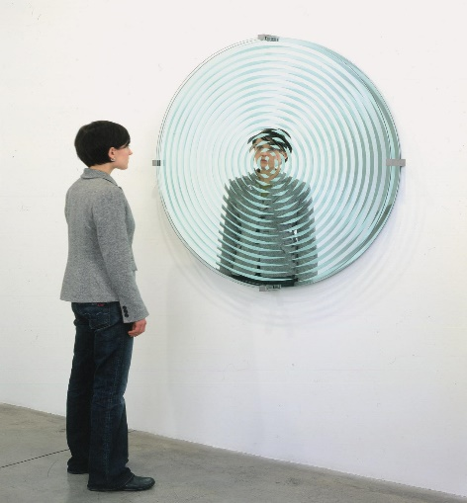
How to Recognize Signs of Stress in Yourself and Others
Feeling stressed
Difficulty managing emotions (irritability, emotional outbursts)
Problems with decision making, memory, or concentration
Problems in relationships (increased conflict/isolation)
Difficulty managing the boundaries (e.g., taking on too much responsibility, having difficulty leaving work behind)
Lack of interest/difficulty feeling connected to events around you
Loss of meaning and hope.
ALL INCREASED DUE TO STRESS FROM COVID-19
Notes:
Darneshia & Joy
As the Helpers:
Recognizing signs and being self-reflective
Being empathetic
Recognizing signs within yourself, acknowledging when you might need support and who is supporting you.

Slide 12
Difficulties of Working with Traumatized Children and Families during Covid-19
Balancing demands of work with children and families impacted by trauma – with demands at home – family pressures, virtual schooling for children, limited support
Social (physical) distancing – which interferes with providing the needed social and psychological support – from families, friends, and others
Notes:
JOY

Slide 13
Professional Quality of Life Scale https://proqol.org/compassion-fatigue
Compassion Fatigue
Burnout
Secondary Traumatic Stress
Compassion Satisfaction
Notes:
JOY

Slide 14
Thoughts about Ways to Provide Support for All Working with Trauma during COVID
Can you find a way to talk “safely” with others about your concerns
Discussions facilitated by professionals who understand trauma and secondary traumatic stress
A time to provide support and problem solve issues
A time to share, learn, demonstrate empathy for others in same situation
Notes:
JOY

Slide 15
The Impact of COVID-19 on Children and Families in Child Welfare
Difficulty in meeting requirements of case plans
Difficulties with virtual family time – concerns about illness, foster parents older -health problems, internet access, lack of iPhone, computer
More difficulty for parents in finding employment or housing
Economic problems that increase stress in families and for children
Increase in abuse and neglect
Increase in domestic violence
Increase in substance use and abuse
Notes:
JOY

Slide 16
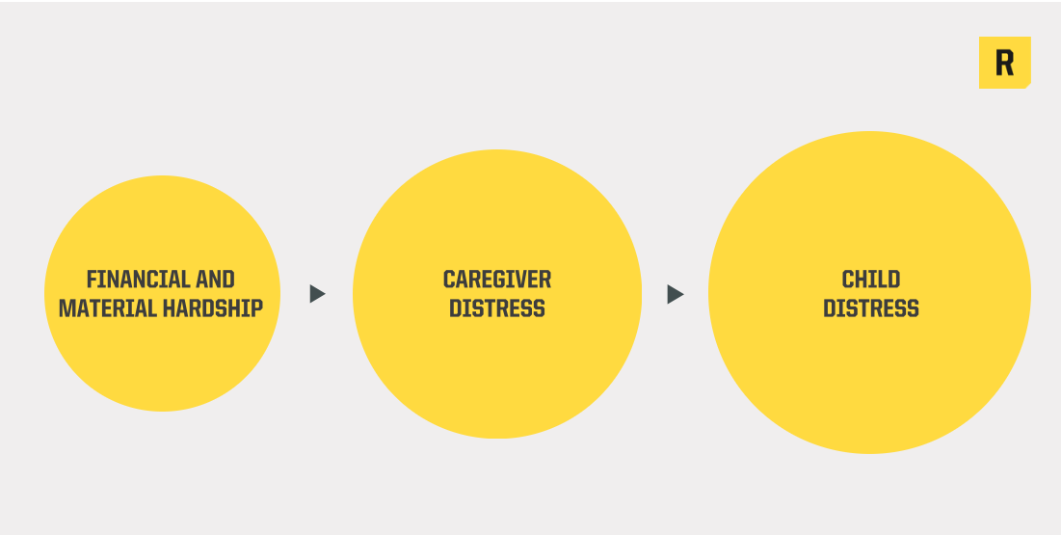
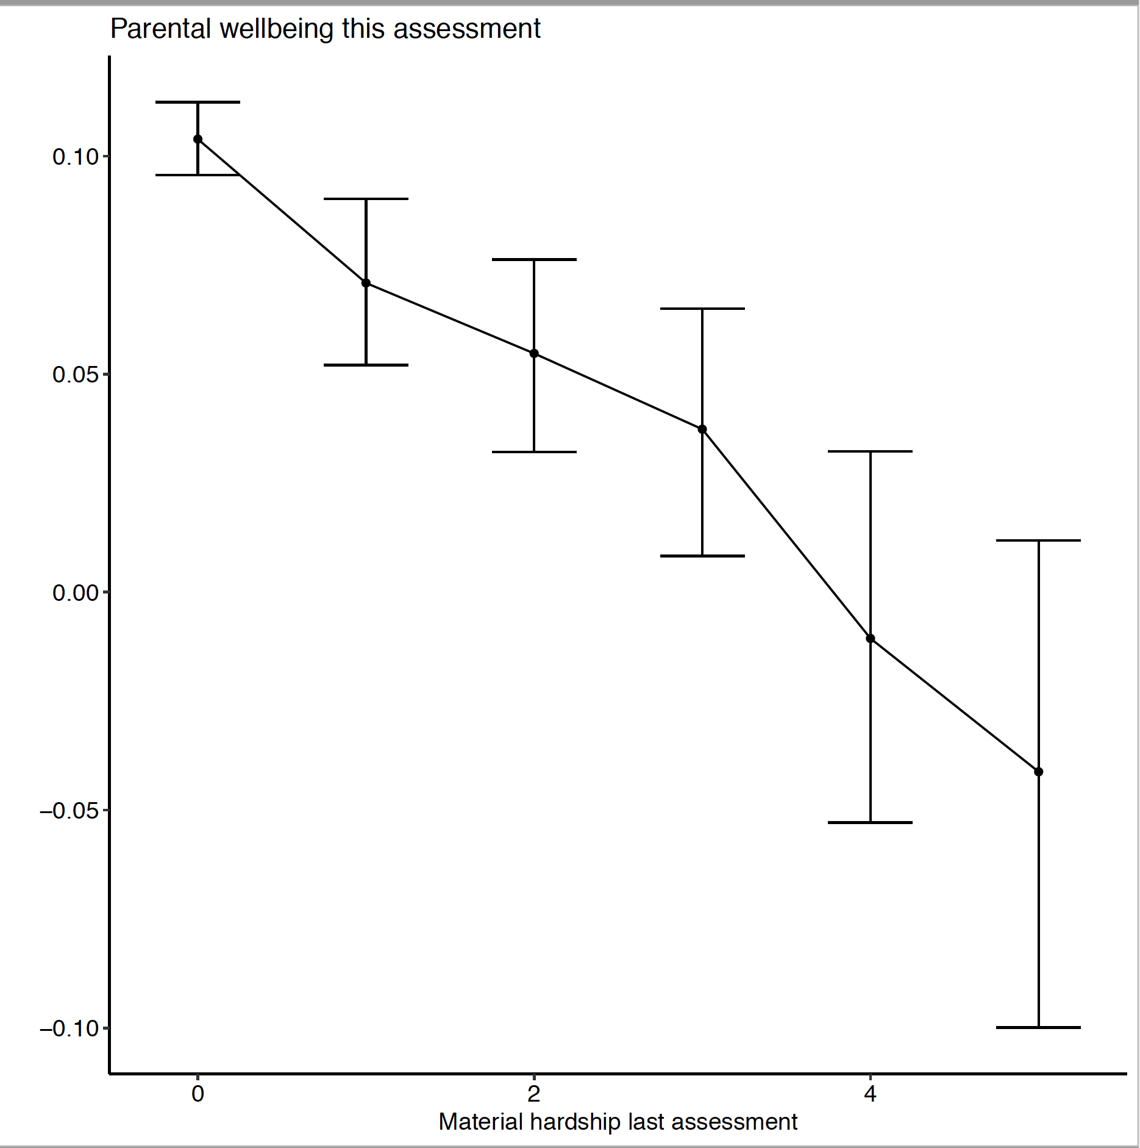
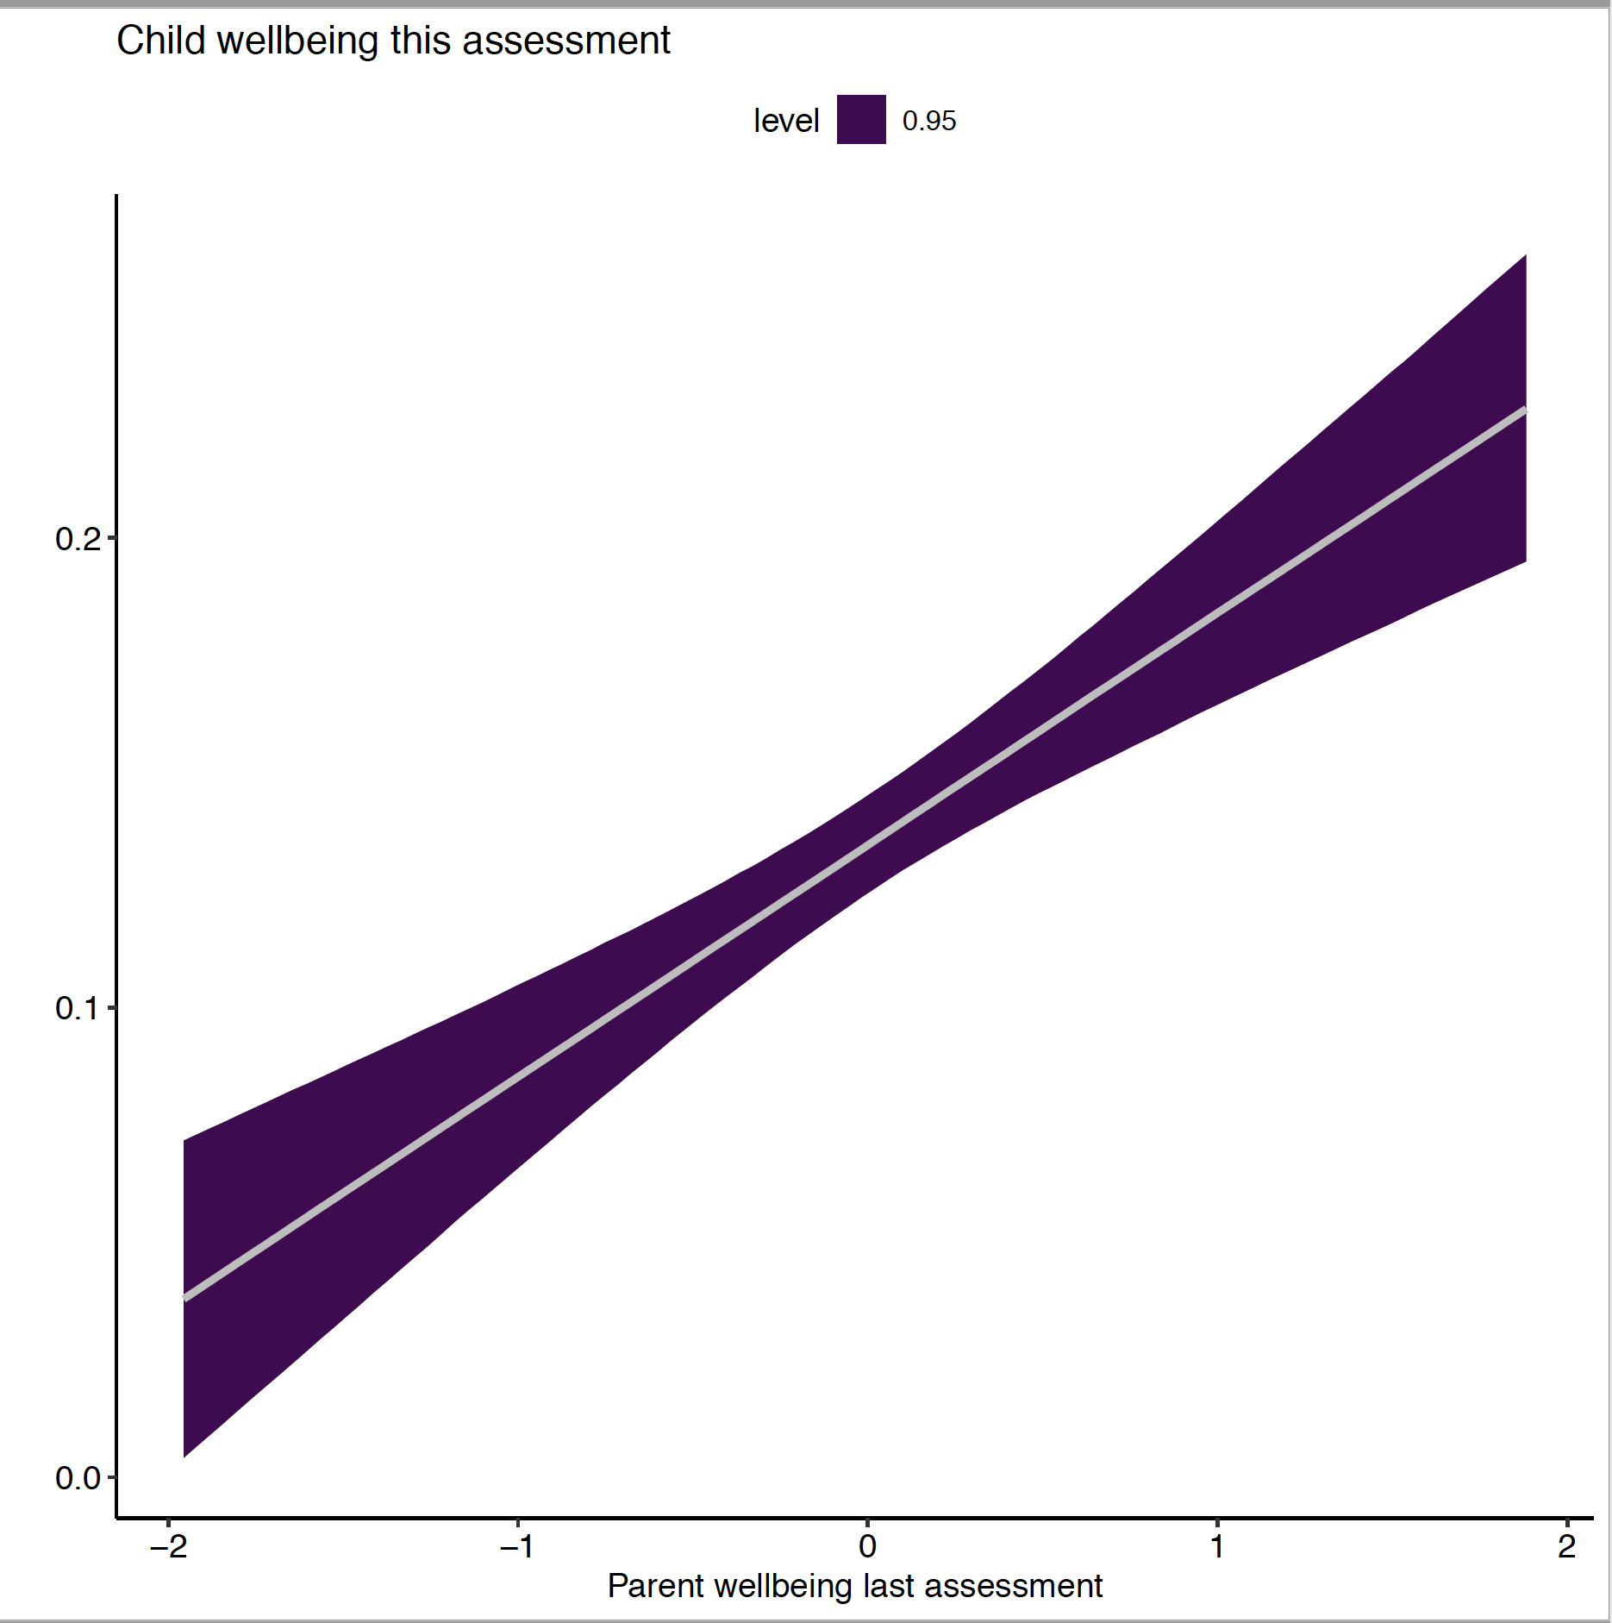
…Rapid Assessment of Pandemic Impact on Early Childhood Development Leading to a Chain Reaction (Philip Fisher, et al, Univ Oregon, 2020-2021)
Notes:
JOY

Slide 17
Why is this data important?
Chronic stress + Lack of parental buffering = Toxic Stress
In light of the extensive scientific evidence of the importance the early years of life on brain development, social/emotional well being, and health across the lifespan, reducing financial difficulties and material hardship among households with young children must become an extremely high priority issue.
We must also attend to the growing inequality gaps based on race/ethnicity, income, and family structure
As long as these hardships exist among households with young children, we can expect to see long term effects on individuals and communities
This is likely to impact the economy for decades
Notes:
JOY
This is why these data are important, but slide is not necessary.

Slide 18
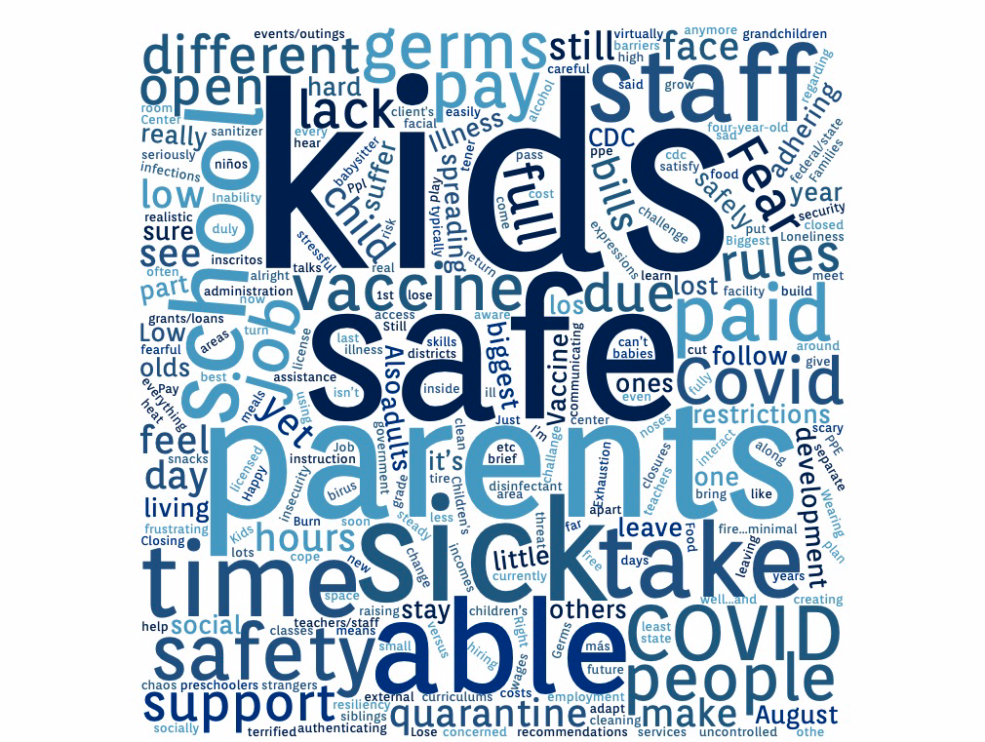
A MOMENT TO REFELCT…
What are the biggest challenges or concerns for you as a provider right now?
www.menti.com
Enter Code:
6538 5291
Notes:
Darneshia
Using menti-meter to have the audience generate a second word cloud

Slide 19
“Surge Capacity” May be Depleted by the COVID-19 Pandemic
Surge capacity is a collection of adaptive systems
mental and physical
We draw upon them for short-term survival in acutely stressful situations, like natural disasters
Natural disasters occur over a short period of time, even if recovery takes longer
With the COVID-19 pandemic, we have all been living with “indefinite uncertainty”
If surge capacity is depleted, it has to be renewed
Ann Masten, Ph.D., Univ of Minnesota

Slide 20
Prevention Strategies related to Secondary Trauma

Slide 21
BALANCE
SELF CARE
Adequate sleep
Healthy nutrition
Relaxation
Physical activity
Socializing

Slide 22
Prevention (personal)
Maintain adequate self-care
Know and honor your personal limitations
Exercise compassion for yourself
Learn to say “no.”
Maintain appropriate boundaries
Stay emotionally connected without becoming over-involved – “Whose needs am I meeting?”
Dilemma – how can we “unwind at home” if we are working virtually at home?
How can we unwind without having flexibility and needing to stay safe?
Notes:
Joy

Slide 23
Prevention at Work
Recognize normalcy of stressors and responses
Reframe the problem to reduce anxiety
Improve eating and exercise habits
Take breaks
Seek support from others
Learn relaxation techniques to incorporate into your routine (even just deep breathing)
Notes:
Darneshia

Slide 24
Primary Concerns mentioned by Judges Contributing to Vicarious Traumatization (based on collaborative work with NCJFCJ and NCTSN)
Caseload – Difficult to manage large caseload consistently
Stress level with work
Non-judgmental role that a judge has to take
Lonely world – cannot share cases; cannot “take cases home”
Does not feel safe for judges to say they are having problems
Anger and frustration
Difficult to talk about personal issues
At time, feelings of helplessness and hopelessness about cases
New concerns with COVID-19 - Inconsistencies related to hearings, difficulties with case plans, risk of illness, concerns about own family
Notes:
Joy

Slide 25
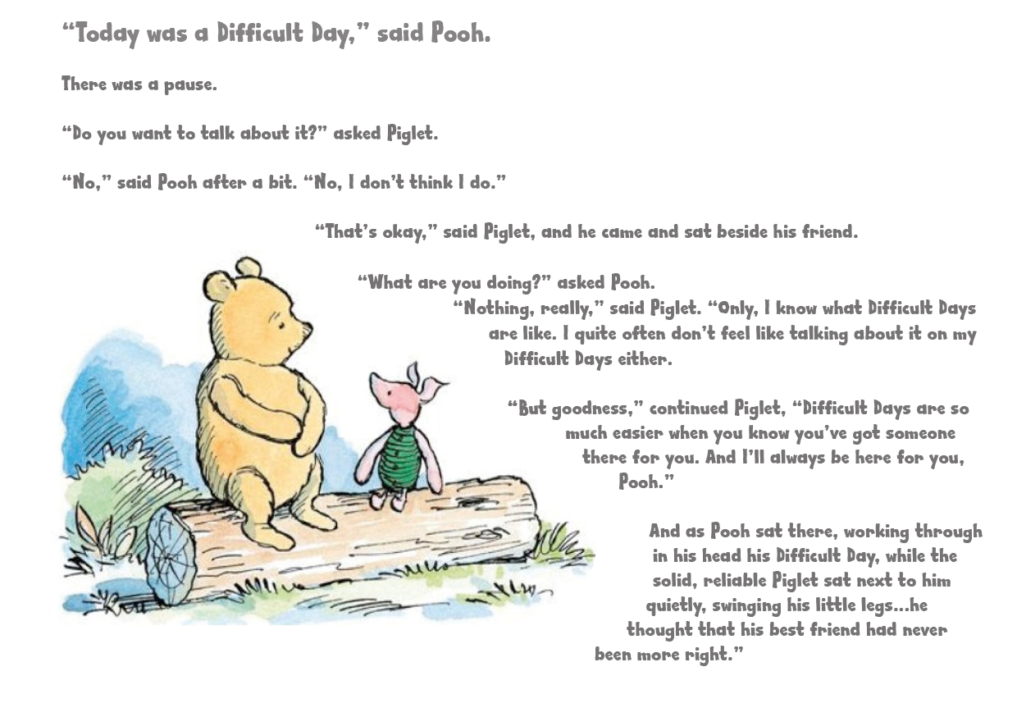
Notes:
Joy

Slide 26
Remember
Put your own “oxygen mask” on first
Notes:
JOY

Slide 27
Research Based Suggestions to Deal with Compassion Fatigue
Ways to improve your mood, increase life satisfaction and mitigate stress include:
Recognizing the risks for yourself
Finding a way to debrief distressing material
Working on self-awareness
Taking a periodic inventory of how balanced your life is or isn’t
Being intentional about balance and protecting yourself

Slide 28
Factors that Buffer Against Compassion Fatigue and Burnout
Use of humor
Regular exercise
Enough sleep
Keeping in touch with friends- virtually during COVID-19
Having hobbies
Taking breaks, if possible
Being part of a healthy team environment
If possible, sharing stressful experiences and receiving support
Notes:
Joy

Slide 29
Self Care is not Selfish
Good sleep
Eating healthy food
Exercise – whatever works for you - even walking
Time for yourself
Meditation if you choose
Notes:
Joy

Slide 30
Compassion Satisfaction
Notes:
Joy

Slide 31
Compassion Satisfaction
The positive aspects of helping
Experience satisfaction in helping others
Providing care
Working with colleagues
Altruism
Beliefs about self
Notes:
Joy

Slide 32
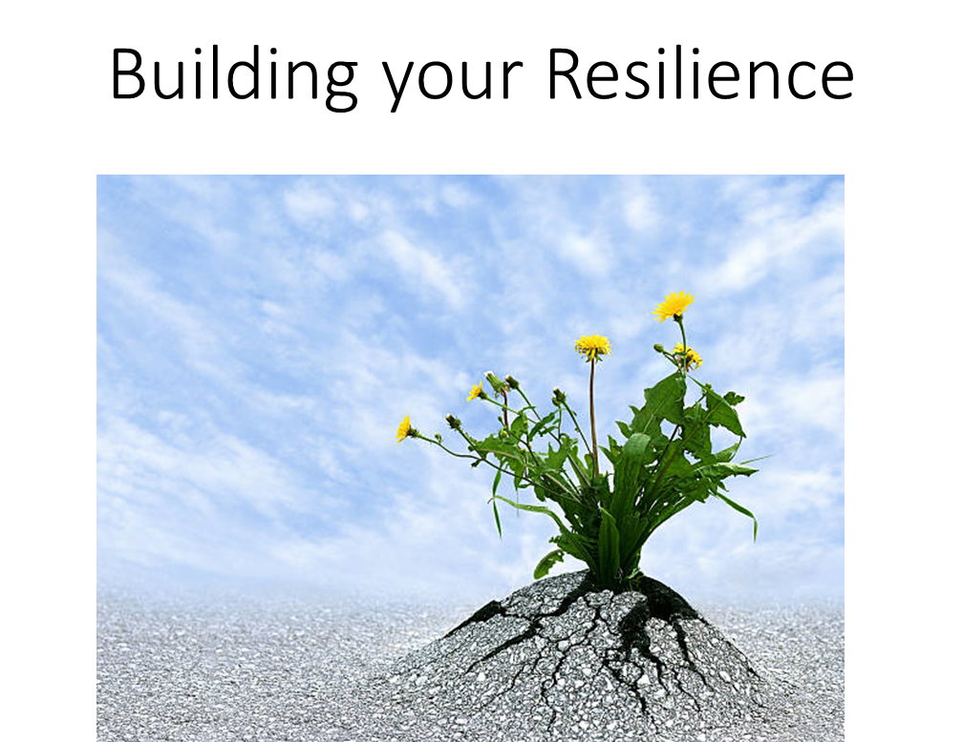
What is Most Important?
Trusting relationships with – family, friends
Gaining support from others
Fostering wellness – self-care for mind and body
Avoid negative outlets
Finding purpose – helping others
It shows strength, not weakness, to ask for help
Notes:
Darneshia
Really emphasize the last bullet

Slide 33
Self Care Resources
Headspace
CALM – Calm.com
4-7-8 breathing technique:
Breathe in through the nose for a count of four
Hold the breath for a count of seven
Part the lips and exhale loudly for a count of eight
Notes:
Joy
Do the breathing technique at the closing

Slide 34
Resources
How-to-maintain-emotional-health-when-working-with-trauma-1 (1).pdf (Osofsky, Putnam, Lederman)
FigleyLudick2017copy.pdf.compassionfatigue.pdf
https://www.americanbar.org/groups/lawyer_assistance/resources/compassion_fatigue/

Slide 35
Questions and Answers
This program is supported by the Health Resources and Services Administration (HRSA) of the U.S. Department of Health and Human Services (HHS) as part of an award totaling $19,581,161 with 0 percent financed with non-governmental sources. The contents are those of the author(s) and do not necessarily represent the official views of, nor an endorsement, by HRSA, HHS, or the U.S. Government. For more information, please visit HRSA.gov.
National Infant Toddler Court Program
ZEROTOTHREE • 1255 23rd Street NW • Washington, DC 20037
www.zerotothree.org

