Slide 1
Making the Case for Babies
Why Infants and Toddlers Should Be A Critical Focus of Preschool Development Grant Birth Through Five
ZERO TO THREE Policy Center
September 2018

Slide 2
Preschool Development Grant Birth-Five (PDG B-5)
Offers a New Opportunity to Support Babies
The new version of the Preschool Development Grant program, PDG B-5, for the first time allows states to include infants and toddlers. PDG B-5 offers states an opportunity to strengthen coordination of existing early childhood care and education (ECCE) services and funding streams to provide equal access to more children birth through age five.
We know from science that how we think, learn, communicate, concentrate, problem-solve, and relate to others when we get to school and later in our lives depends in large part on the experiences we have and the skills we develop during the earliest days, months, and years.
For this reason, we urge states to consider how they can intentionally focus on infants and toddlers in their PDG B-5 applications.
This PowerPoint provides an overview of early childhood brain development and how the mixed delivery ECCE system can support it.

Slide 3

Learning Happens From the Start
Brain Development Basics

Slide 4

The Earliest Years Are Critical For Healthy Brain Development
We know from science that brains are built from the bottom up.
During the first three years of life, the brain undergoes its most dramatic development, and children acquire the ability to think, speak, learn, and reason.
The early experiences of young children will shape the architecture of their brains in enduring ways and build the foundation – whether strong or weak – for their future development.

Slide 5
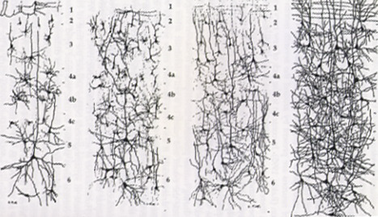
Babies Gain Knowledge at a Staggering Rate:
Proliferation of Neural Connections in the First 6 Months
1 Million New Connections Every Second
newborn 1 month 3 months 6 months

Slide 6
The Science Behind Brain Development
Brains are built from the bottom up. Like building a house, they need to start with a strong foundation.

Slide 7
Development of Neural Connections for Different Functions Peaks in Early Years, Laying Critical Foundations for Learning
Higher Cognitive Functions
Language
Sensory Pathways
(Vision, Hearing)
Self-Regulation
FIRST TWO YEARS
-8 -7 -6 -5 -4 -3 -2 -1 1 2 3 4 5 6 7 8 9 10 11 1 2 3 4 5 6 7 8 9 10 11 12 13 14 15 16 17 18 19
Birth
(Months)
(Years)
Slide courtesy of Ross A. Thompson
Source: C. Nelson (2000)

Slide 8
Neural Connections for Basic Functions Form the Brain’s Foundation
“Blooming”--the formation of these
connections--peaks
early in life.
12-24 months: connections for thinking and understanding
(cognitive development)
About 9 months: connections for language
Early in 1st year: connections for sight and hearing
Some connections must be “pruned” over time as the brain reached its adult architecture.
But which ones?

Slide 9
Two Basic Ingredients Affect Brain Construction –
That Is, Which Connections Are Strengthened or Lost
Early experiences shape brain architecture. Babies learn through:
  Quantity, quality, and complexity of language
  Understanding emotions
  Eye gaze and imitation
  Back-and-forth interactions
  Building one skill on top of another
Experiences don’t just happen. They unfold within relationships with trusted adults who:
  Teach us who we are and how the world works
  Affect how we trust and interact with people
  Give us the confidence to explore and learn

Slide 10
Critical Building Materials: Developmental Domains Go Hand in Hand
How we think and understand (cognitive development)
How we relate to others
(social-emotional development)
The bricks and mortar of brain construction
Institute of Medicine. From Neurons to Neighborhoods. 2000

Slide 11
The Foundation for All Learning that Follows Depends on the Quality of These “Materials”
Strong…
  Connections for important skills are reinforced through nurturing relationships that facilitate pleasurable everyday activities (e.g., talking, playing, reading) and encourage exploration.
Or fragile...
      Important connections are lost when a baby lacks positive experiences to reinforce them (no language-rich activities, opportunities to play and explore) and has negative experiences with caregivers (e.g., cries are ignored, no one smiles or talks, or talk is harsh) that stifle confidence and curiosity needed for learning.

Slide 12
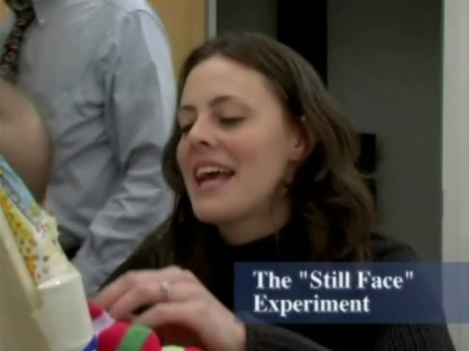
How Important Are Early Relationships?
Connecting with Caregivers Helps Babies’ Brains Organize
This video from the “Still Face” experiment illustrates attachment between a baby and mother, and the effects of non-responsiveness on the part of the mother. Attachment and connection are vitally important for young children.
Copyright © 2007 ZERO TO THREE www.zerotothree.org
Two versions of this experiment can be found at:
http://www.youtube.com/watch?v=apzXGEbZht0 and
http://www.zerotothree.org/child-development/early-childhood-mental-health/

Slide 13
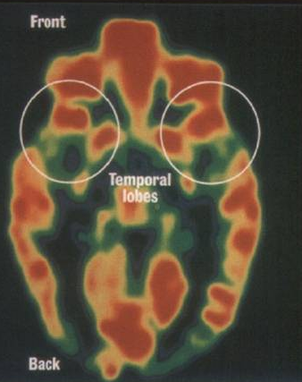
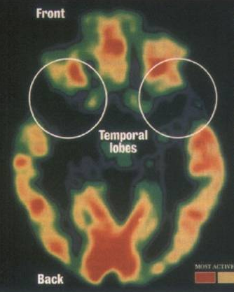
When Babies Are Not Nurtured, Brain Development is Undermined
Healthy, Typically Developing Brain:
Significant brain activity, indicated by red areas.
Brain of Romanian Orphan: Severe physical and emotional neglect when young. Particular lack of activity in temporal lobe.
The temporal lobe is associated with processing auditory stimuli, comprehension, language, behavior, and short and long-term memory.
Notes:
13

Slide 14
When Babies Are Not Nurtured, Brain Development is Undermined (cont.)
Scientists and clinicians who have researched early adverse experiences now conclude that they become integrated into our bodies and literally “get under our skin” in the form of impairments in:
  Brain architecture
  Immune status
  Metabolic systems
  Cardiovascular functions
These in turn lead to poor lifelong developmental, educational, and health challenges.

Slide 15

What Happens When Children Don’t Get What They Need for a Strong Start in Life?

Slide 16

What’s the Picture for Our Nation’s Children?
6.8 million children under 3 (61%) have at least one risk factor for poor health, social, or developmental outcomes.
5.7 million children under age 3 (48%) live in low-income families.
At age 2, children in the lowest socio-economic group are behind more affluent children in measures of language, cognitive abilities, and attachment.

Slide 17
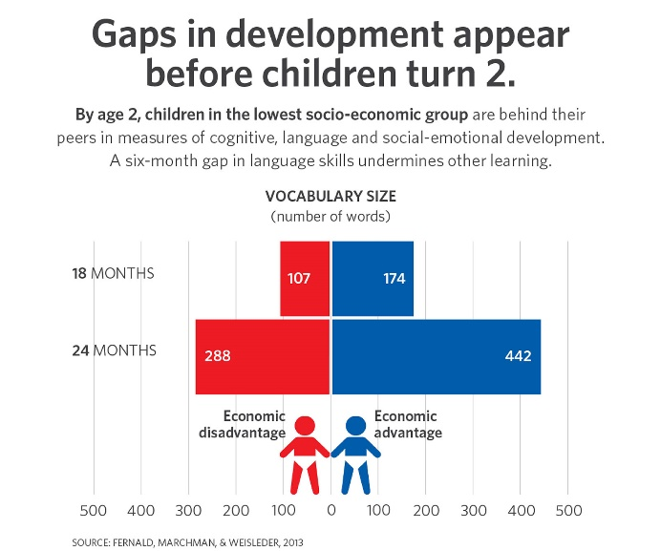
Different Opportunities = Disparities in Development
The “Word Gap” is one example
Language gives us the ability to communicate verbally and later through print. Strong language skills at age 3 predict academic success in grade 3. When children lack this key to learning, they cannot easily master academic content presented in school.

Slide 18
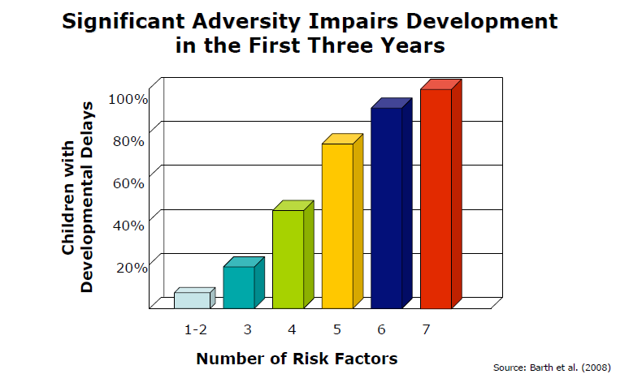
It’s More Than Just Words: Multiple Risk Factors Increase Developmental Delays
This study of children experiencing maltreatment showed that the cumulative effect of multiple risk factors is an extremely high likelihood of a developmental delay.
Risk Factors Examined: maltreatment; minority status; single caregiver; poverty; domestic violence; caregiver substance abuse; caregiver mental health problem; low caregiver education; biomedical risk condition; teen-aged caregiver; 4 or more children in the home

Slide 19
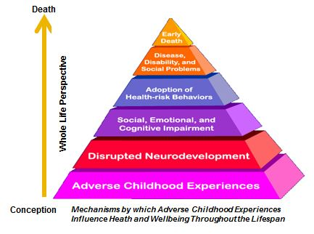
Early Childhood Adversity Has Lifelong Health and Social Consequences
Early Adverse Experiences
Emotional, physical, or sexual abuse
Emotional or physical neglect
Household Dysfunctions
  Mother treated violently
  Household substance abuse
  Household mental illness
  Parental separation or divorce
  Incarcerated household member
Increase Risk as Adults of:
Alcohol or substance abuse
Depression/suicide attempts
Heart disease
Unhealthy behaviors
Early death
Source: CDC Adverse Childhood Experiences Study http://www.cdc.gov/violenceprevention/acestudy/index.html

Slide 20

High-Quality ECCE Programs Can Promote Children’s Development
High-quality ECCE programs improve infants’ and toddlers’:
  Early learning
  Cognitive and language development
  Social and emotional development
  School achievement

Slide 21
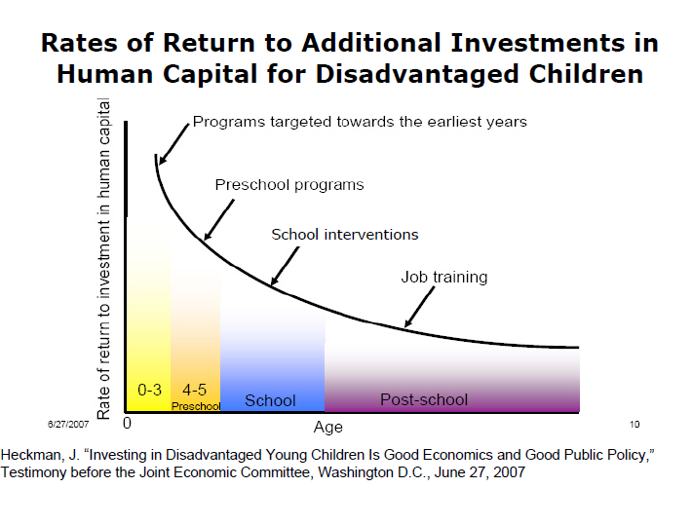
Investing in the Early Years Pays Off
Dr. James Heckman’s return on investment studies have shown that for every dollar invested in select early childhood programs, savings of almost $4 to $17 can be realized.
The rate of return on public investment is highest in the first three years.
Investing so that children have what they need in the first three years of life boosts the impact of Pre-K investments.

Slide 22
Why Should Infants and Toddlers Be a Critical Focus of PDG B-5?
The Mixed Delivery Early Childhood Care and Education System is Critical for Babies’ Brain Development

Slide 23

ECCE Settings Are An Important Brain Construction Site
Second only to the family, ECCE is the setting in which development unfolds for many infants and toddlers
  6 million infants and toddlers in the United States spend some or all of their day being cared for by someone other than their parents (more than half of all children under age 3).
  62% of mothers with infants are in the labor force.
  National studies show the majority of infant-toddler child care is of poor to mediocre quality.

Slide 24
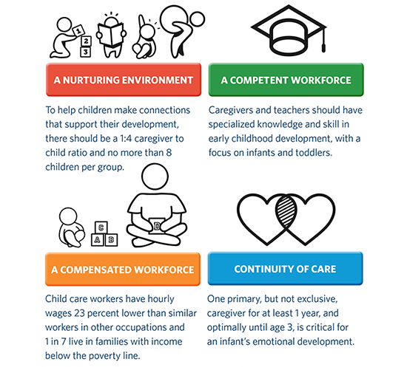
Elements of High-Quality ECCE for Infants and Toddlers

Slide 25
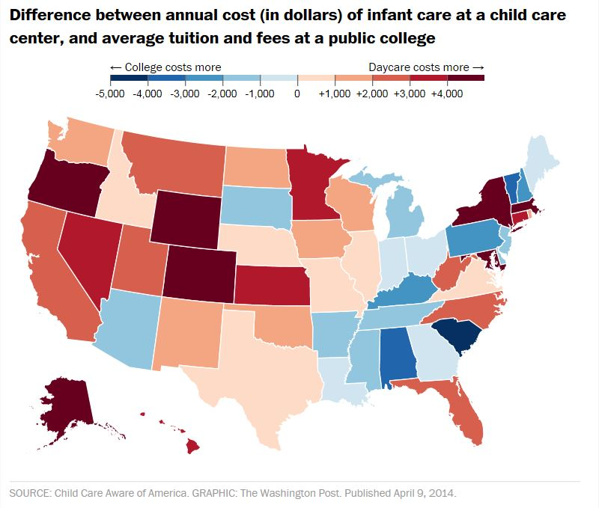
High-quality ECCE Is Often Out of Reach
Infant-toddler care is unaffordable for many families.
  In 33 states and Washington D.C., the cost for an infant in center-based child care is more than college tuition at a state university.
  42% of infants and toddlers live in low-income families (approximately 4.9 million).
  Child care assistance for low-income families reaches fewer than 1 out of every 6 eligible children.

Slide 26
The Opportunity
The PDG B-5 offers an opportunity for states to improve families’ access to high-quality, affordable ECCE that will support their infants’ and toddlers’ healthy brain development.

Slide 27
States Could Use the PDG B-5 To Address ECCE System Challenges Specific to Infants and Toddlers
ECCE systems often do not adequately address the unique needs of infants and toddlers through quality standards and workforce development requirements.
The “baby voice” is often not well represented on state or local coordinating bodies responsible for assessing and responding to families’ needs.
ECCE models that offer comprehensive child and family services, such as Early Head Start, serve only a fraction of those eligible.
Families’ need for infant-toddler care often exceeds the supply – this problem is magnified in rural areas and during non-traditional hours, limiting parental choice.
It is more expensive for providers to care for infants and toddlers than older children, contributing to lower supply.
Working parents in need of ECCE for their babies and toddlers need a better understanding of the options available to them and what high-quality care looks like for babies.

Slide 28
Babies Need Your Support!
Ensure infant-toddler stakeholders are involved in planning for your state’s PDG B-5 application.
Consult other ZERO TO THREE PDG B-5 resources to help you include an intentional focus on infants and toddlers in your application at www.zerotothree.org/pdg.
  The Preschool Development Grant Birth-Five (PDG B-5) Offers A New Opportunity to Support Babies and Toddlers: A Tool to Intentionally Include Infants and Toddlers in PDG B-5 – this document offers recommendations for specific strategies that states can include in PDG B-5 applications to improve outcomes for babies.
  Including Infants and Toddlers in PDG B-5 Resource List – this companion to the document above provides links to briefs, tools, and videos that go into detail about how to implement strategies for strengthening the ECCE system for babies.
If you are interested in consulting with ZERO TO THREE Policy Center staff about your PDG B-5 application, please reach out to Barbara Gebhard, Assistant Director of Public Policy, at bgebhard@zerotothree.org.

Slide 29
ZERO TO THREE
ZERO TO THREE is a national nonprofit organization that informs, trains, and supports professionals policymakers, and parents in their efforts to improve the lives of infants and toddlers.
  We train professionals and build networks of leaders.
  We influence policies and practitioners.
  We raise public understanding of early childhood issues.
All our work is:
  Grounded in research and experience
  Multi-disciplinary
  Culturally responsive

